Slide 1


Slide 2
react to breakthroughs
The industry has been slow to _____ ___ these ____________ in technology. 对科技的突破作出反应
Many young people _____ _____ traditional values. 反对，反抗
Iron ____ ____ water and air to produce rust. 发生化学反应
reaction
My _________ _______ was a shock. 当即的反应
An emergency fund was ___ ___ (设立)___ _______ ___ the famine. 针对……作出反应
She had a severe allergic ________ ____ the drug. 对……有过敏反应
a skilled driver with quick-reactions
react against
reacts with
immediate reaction
set up in reaction to
reaction to
Notes:
反应敏捷的熟练司机(反应能力)

Slide 3
interpreter
interpretation
misinterpret
gentler, gentlest
gently
gentleness
gentle exercise / a gentle breeze / gentle and comforting / gentle, rolling meadows
Cook for 30 minutes over a gentle heat.
despite repeated requests
the work is dull and repetitive.
All musicians learn by repetition.
Notes:
错误地阐释
温和的运动
轻柔而且抚慰人心 consoling
缓缓起伏的牧场

Slide 4
Make sure the firm is competent to carry out the work.
be competent in/at his work
incompetent
have the competence to do sth
学生将获得各种技能的能力。
Students will gain competence in a wide range of skills.
gain a high level of competence in English
我们一直都认为他是个正直而且专业能力很强的人。
We've always regarded him as a man of ________ and high _____________________.
技术能力
The government performed ___________ in the face of multiple challenges.
integrity
professional competence
technical competence
competently
Notes:
获得高水平的英语能力
专业／技术能力

Slide 5
obtain v. to get sth, especially by making an effort (attain)
You will need to ______ __________ ______ the manager. 得到允许
gain v. to obtain or win sth, especially sth that you need or want
获得……的机会
获得声誉
获得信心
体重增加
The party made considerable gains at local elections.
Nothing ventured, nothing gained.
No pain, no gain.
obatin permission from
gain access to…
gain a reputation
gain confidence
gain weight
/ prevent weight gain
Notes:
gains / advantages
大胆去做venture to do 不入虎穴焉得虎子

Slide 6
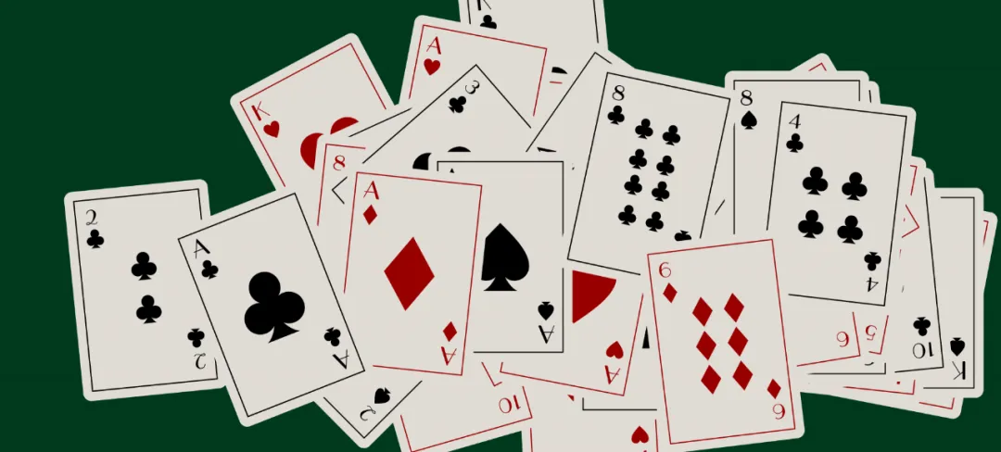
a business suit / a diving suit
The suits are called hearts, clubs, diamonds and spades.
a divorce suit
follow suit
If you want to go by bus, that suits me fine.
I’ve found a job that ________ very well. 适合我
Blue suits you. You should wear it more often.
We have been offering a wide variety of walking holidays to _____ _____ _____ for just three years. 满足不同需求/口味
suits me
suit all tastes
Notes:
file a suit to sb
要是你想坐公共汽车走，我也没问题。

Slide 7
We have been negotiating with the company for more pay.
谈判技巧
Union leaders have negotiated an agreement for a shorter working week. 达成一致
negotiate a settlement
We want to settle the problem calmly by direct ___________ with that company.
The terms of employment are ____________.
__________ for both sides agreed to meet again tomorrow.
negotiating skills
negotiation
negotiable
Negotiators
Notes:
达成解决措施

Slide 8
entrepreneur
a straightforward process
我来把它说得更直截了当一些。
Let me put it more straightforwardly.
She is very blunt, very straightforward and very honest.
仍有待解决的冲突和摩擦
conflicts and frictions that remain to be resolved
Notes:
企业家
easy: simple straightforward language
她非常直率，很坦诚，也非常诚实。in blunt terms
tensions

Slide 9
empathy: understand another person’s feelings
sympathy: feel sorry for another person’s misfortune
empathetic
sympathetic
empathize
sympathize
He had great empathy for other people's situations
对他人所处境况有同感
empathize with sb
an empathetic listener 善解人意的听者
relate to / identify with / resonate with
Notes:
共鸣，同感
同情
善解人意的，会移情的

Slide 10
我不同情简，那都是她自己的错。
I _____ ___ ________ _____ Jan, it's ____ ____ _____ ______.
I’d like to express/offer/extend my deepest sympathy to the victim’s family.
The seamen went on strike in sympathy with the dockers.
out of sympathy with
sympathize with sb 同情某人
She was very sympathetic to the problems of adult students.
a sympathetic listener 体恤别人、有同情心的听者
She met people in London who were sympathetic to the Indian freedom struggle.
She sounds a most sympathetic character. 讨人喜欢的(角色)
have no sympathy for
all her own fault
Notes:
她对成年学生的问题深表同情
她在伦敦结识了一些支持印度独立运动的人。
她听起来是个很招人喜欢的人物。富有同情心，形容人或人的态度时，表示关心并愿意帮助解决问题
nice, likable

Slide 11
____________________, I would resign immediately. 如果我在你的处境下 (be in one’s shoes 处在……的境地)
Don’t be cross with him. Try to put yourself in his shoes.
Recent pressure at work may account for his behavior.
Those who voted Zelensky accounted for 72%.
These figures do not _____ _____ ______ changes in the rate of inflation.考虑
She was told to wear flat shoes _____ _____ _____ her back problems. 因为
On no account should you…
If I were in your shoes
take into account
on account of
Notes:
I wouldn't want to be in his shoes
to be cross with sb;
生某人的气
explain
make up / comprises

Slide 12
The conference approve a plan. vt. 批准，通过
My mom didn’t approve of my/me marrying him. vi. 同意，赞成
My mom strongly ___________ of …
I desperately want to win her _________.
meet with one’s approval
Finally my mom nodded ______ ______. 表示赞同
The bill will be ______ ______ _______ by Congress. 提交批准
be subject to approval 需经某人批准
disapprove
approval
in approval
submitted for approval
Notes:
可能遭受，受……支配

Slide 13
He made a rude gesture at the driver of theother car.
They communicated entirely ___ _______. 他们完全用手势交流
They sent some flowers ___ __ _______ ___ _________ ____ the parents of the child. 以表同情
以表示我们的善意
It was a nice gesture to invite his wife too.
“I see you read a lot,” he said, gesturing at the wall of books.
gesture (to sb) that ...示意某人做某事
She gestured for them to come in.
by gesture
as a gesture of sympathy to
as a gesture of goodwill
Notes:
手势
以表示
也是友好的表示

